Slide 1

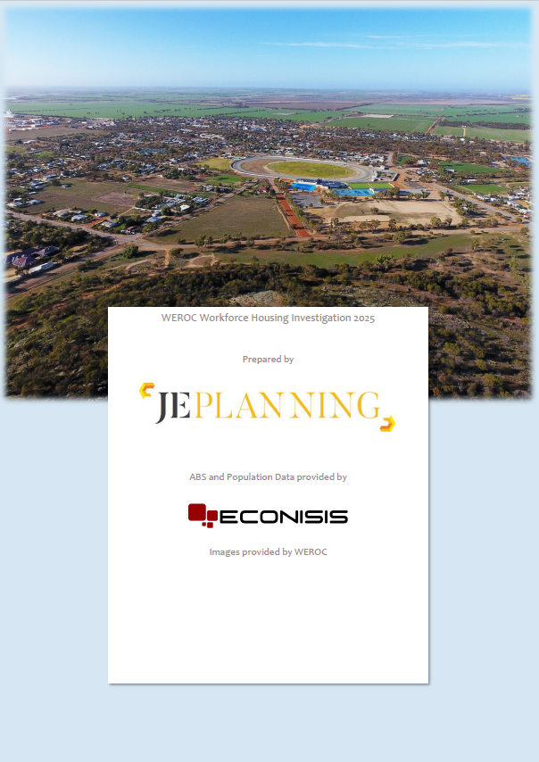

Slide 2
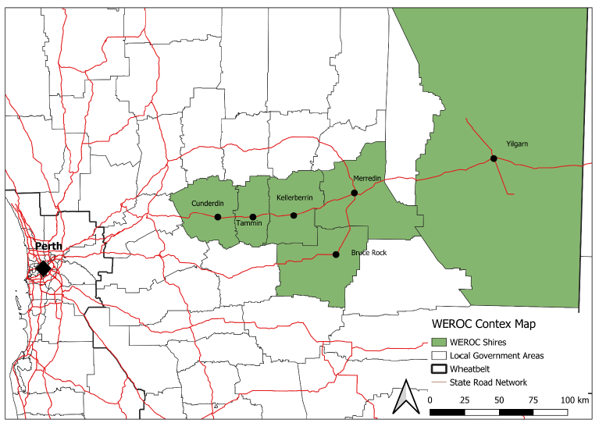
WEROC SUB-REGION
The Shire of Tammin
The Shire of Yilgarn
The Shire of Merredin
The Shire of Kellerberrin
The Shire of Bruce Rock
The Shire of Cunderdin
'Anyone employed or self-employed to undertake a role in childcare, retail, service industry, commercial, tourism, education, government, community organisations, industrial and agricultural workforces either for the public service, or private business which contributes to the economy of WEROC subregion.'

Slide 3
REPORT STRUCTURE AND METHODOLOGY
The WEROC Workforce Housing Investigation (WWHI) comprises three phases :
Inception
Housing Demand Data (Stakeholder Engagement)
WEROC Workforce Housing Needs Analysis
Phase 1
Inception
Project Plan
Phase 2
Housing Demand
Business Community Survey
Phase 3
Workforce Housing Needs Analysis
Housing Profile for each LGA
Literature Review
Stakeholder Engagement Strategy
Local Government Survey
Questionnaire and Survey to State Government Stakeholders (WACHS/GROH)
Compilation of ABS Data Sets
Summary and Profiling of Population, demographic and socioeconomic data for each LGA
Stakeholder Engagement Outcomes Report
Trend analysis
Gap Analysis
Housing demand forecast Scenarios for the WEROC Subregion
Meeting with CEO’s (working group)

Slide 4
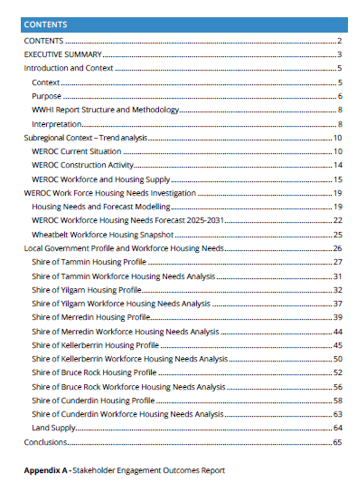
WEROC WORKFORCE HOUSING INVESTIGATION
The WWHI presents evidence for the Cost Benefit Analysis and Business Case (Econisis), and addresses the :
WEROC Subregional Context – Trend Analysis and workforce housing needs until 2031
Local Government Profile and Workforce Housing Needs to 2031
Estimated Land Supply to accommodate housing demand

Slide 5
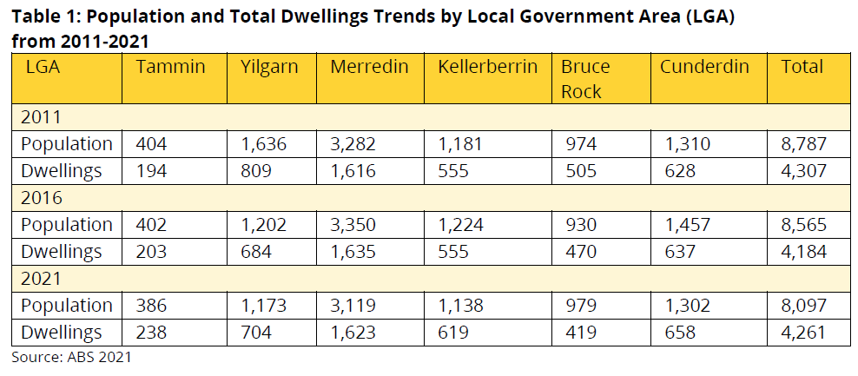
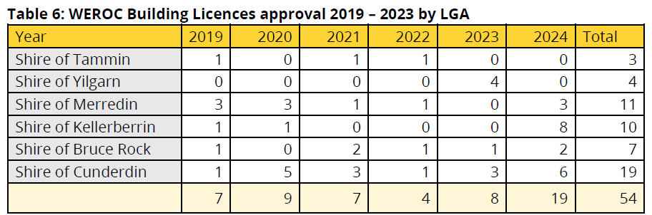
WEROC SUB-REGIONAL CONTEXT
Population remains relatively stable. Statistics reveals a decline of 690 people across the subregion between 2011- 2021.
The population distribution across the WEROC Shires in order of size includes:
Merredin (39%)
Cunderdin (16%)
Kellerberrin (14%)
Yilgarn (14%)
Bruce Rock (12%)
Tammin (5%)
The WEROC Sub-regional housing construction activity (LGA survey) over the past five years averaged 9 dwellings per annum.

Slide 6
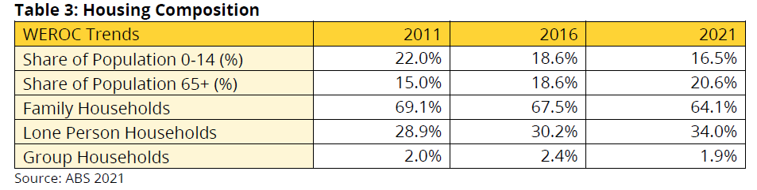
WEROC SUB-REGIONAL TRENDS
The subregion's average occupancy is 2.3 persons per household.
Single houses represent 94% of the housing stock.
Lone households represent 34% of households.
Decrease in Family Households (5%) and the share of the population for 0-14 years has also dropped 5.5%.
The proportion of population 65+ has increased by 5.6%.

Slide 7
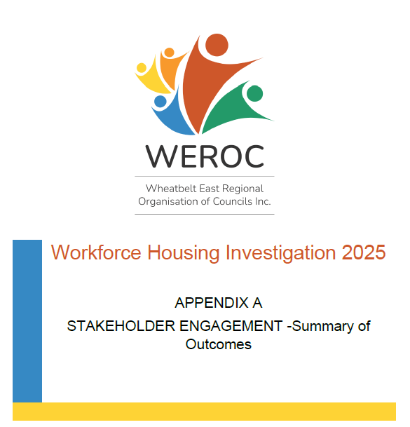
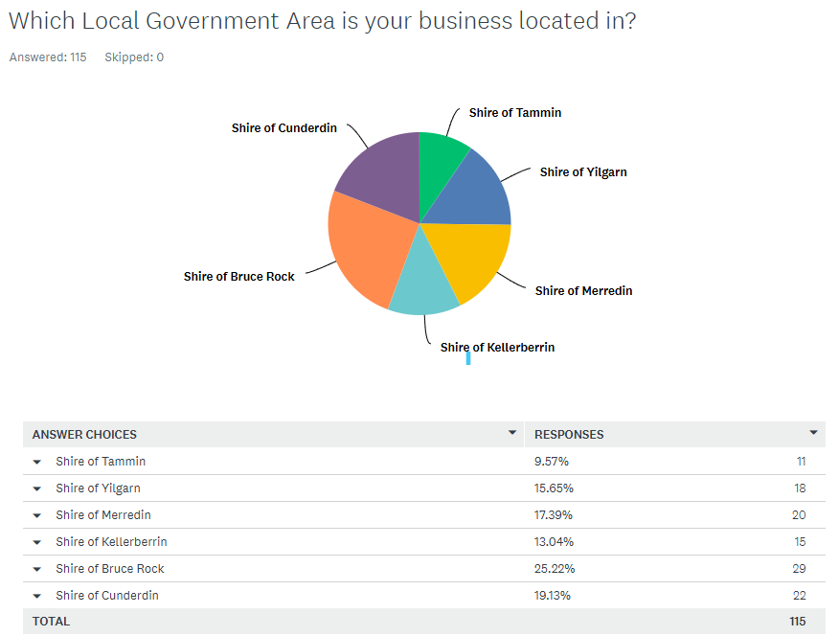
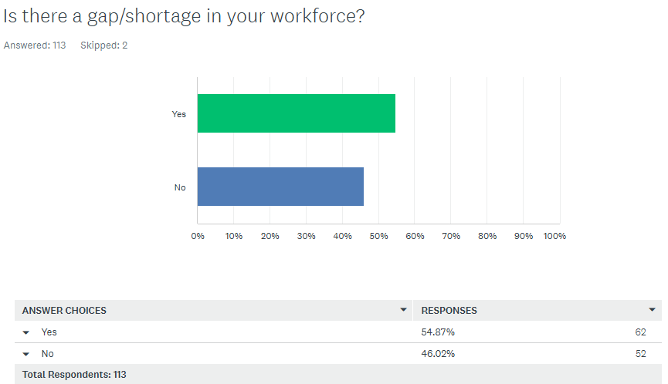
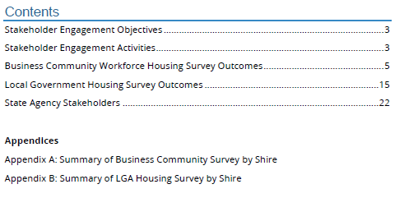
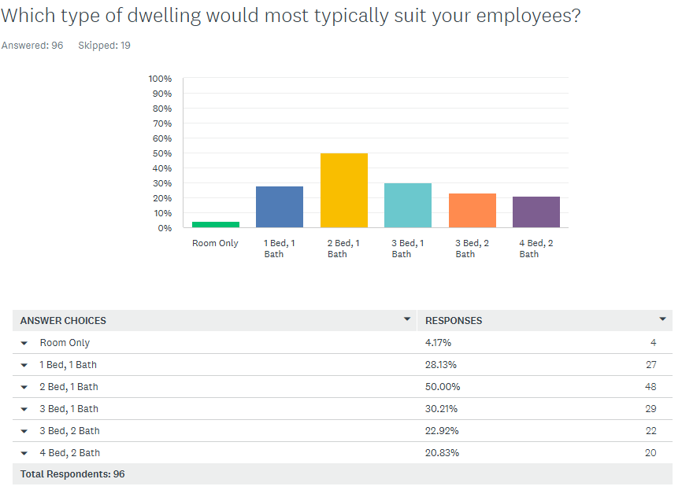
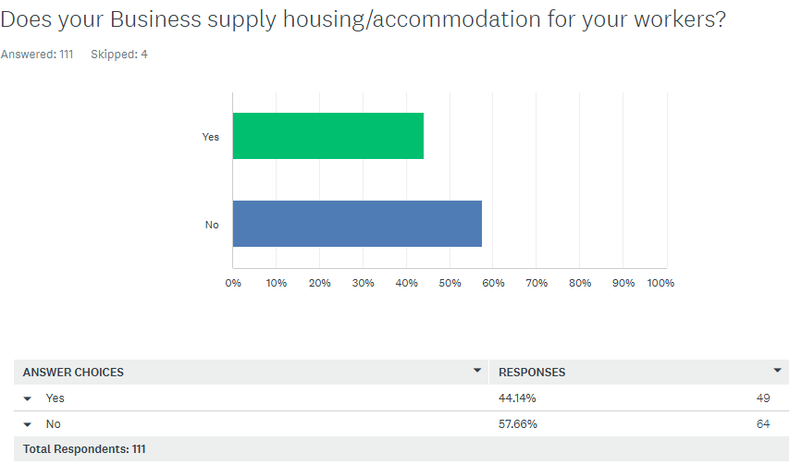

Slide 8
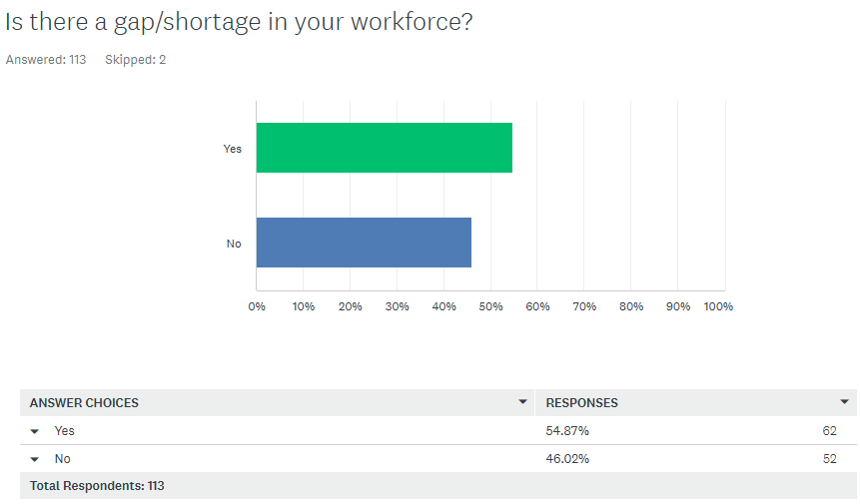
WEROC SUB-REGIONAL WORKFORCE
The business community survey revealed:
Approximately 54% of businesses in the Study Area reported a gap in their workforce.
Average gap of 1.4 workers per business (ranging 0.5 to 2.5)
Estimated WEROC Subregion needs an additional 333 workers to meet current needs.
The comments received from business owners regarding housing needs for workers include the need for:
Additional housing/rentals
Additional short-term accommodation
Additional singles accommodation
Additional family dwellings
Better quality accommodation

Slide 9
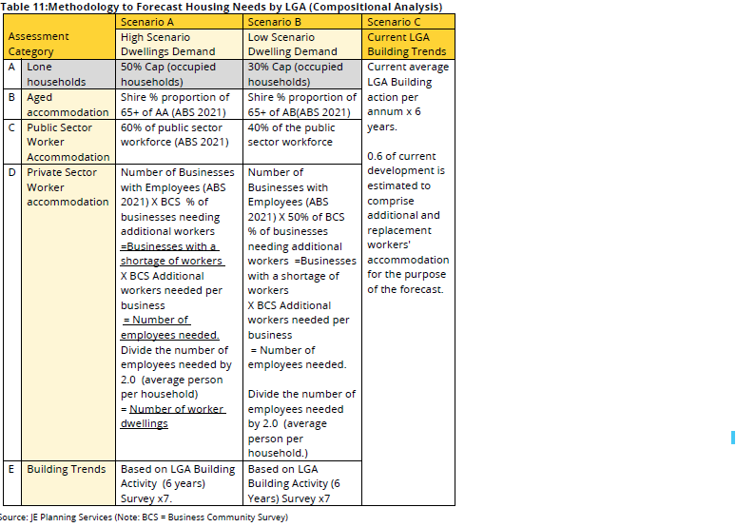
HOUSING NEEDS MODELLING METHODOLOGY
This analysis considers the current construction trends and surveyed workforce accommodation gaps, focusing on the provision of smaller housing options for lone and group households.
High Scenario (A) and
Conservative Scenario (B)
Business as usual. Scenario (C )

Slide 10
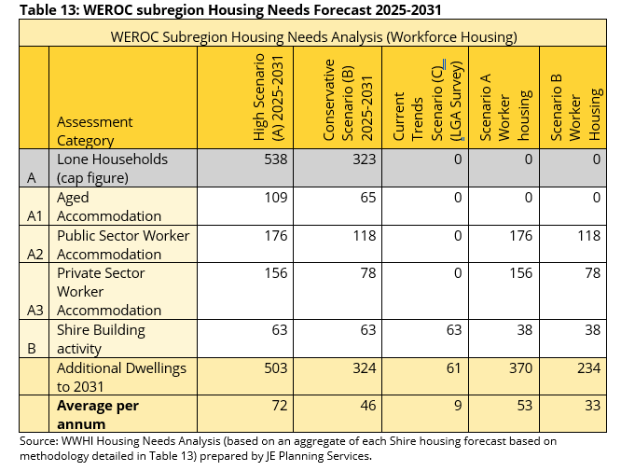
WEROC STUDY AREA HOUSING NEEDS
Overall demand for housing in the Study Area is conservatively 5 times greater than current building activity.
The estimated demand for housing the workforce ranges between 234 and 370 dwellings by 2031.
Estimate demand between 33 and 53 additional worker accommodation units across the study area per annum.

Slide 11
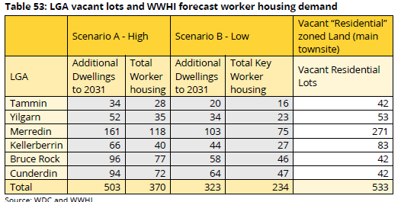
WEROC TOWNSITES – VACANT LAND
The Wheatbelt Development Commission provides high-level numbers of vacant “Residential” zoned lots.
Housing Action Plans will demonstrate the capacity of the land to accommodate short to medium term development.
Adequate zoned land available subject to servicing to meet workforce housing needs to 2031.
Challenges for Shires of Bruce Rock and Cunderdin.

Slide 12
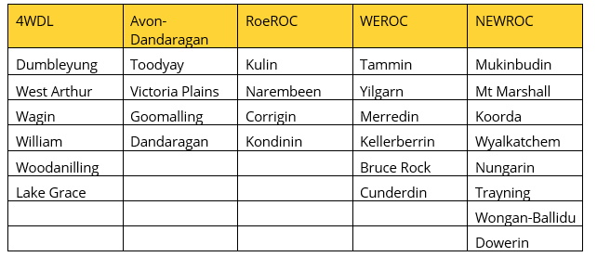
WHEATBELT SNAPSHOT
Aggregate of all LGA’s - 60% of businesses require an additional 1.4 workers to meet their needs.
4WDL - 60% of businesses require an average of 1.3 additional workers.
AROC -Dandaragan - 62% of businesses require an average of 1.5 additional workers.
ROEROC – 61% of businesses require an average of 1.3 additional workers.
WEROC - 54% of businesses require an average of 1.4 additional workers.
NEWROC - 64% of businesses require an average of 1.4 additional workers.
The average response across all studies so far is 18% of businesses. WEROC survey response rate reflects 26% of businesses with employees.
The majority of businesses with employees across the wheatbelt need additional staff.

Slide 13
NEXT STEPS
Draft WWHI report circulated - July 2025 (review process)
WDC Housing Action Plan and Development Models (August/September)
Econisis CBA and Business Case (September)

